Slide 1
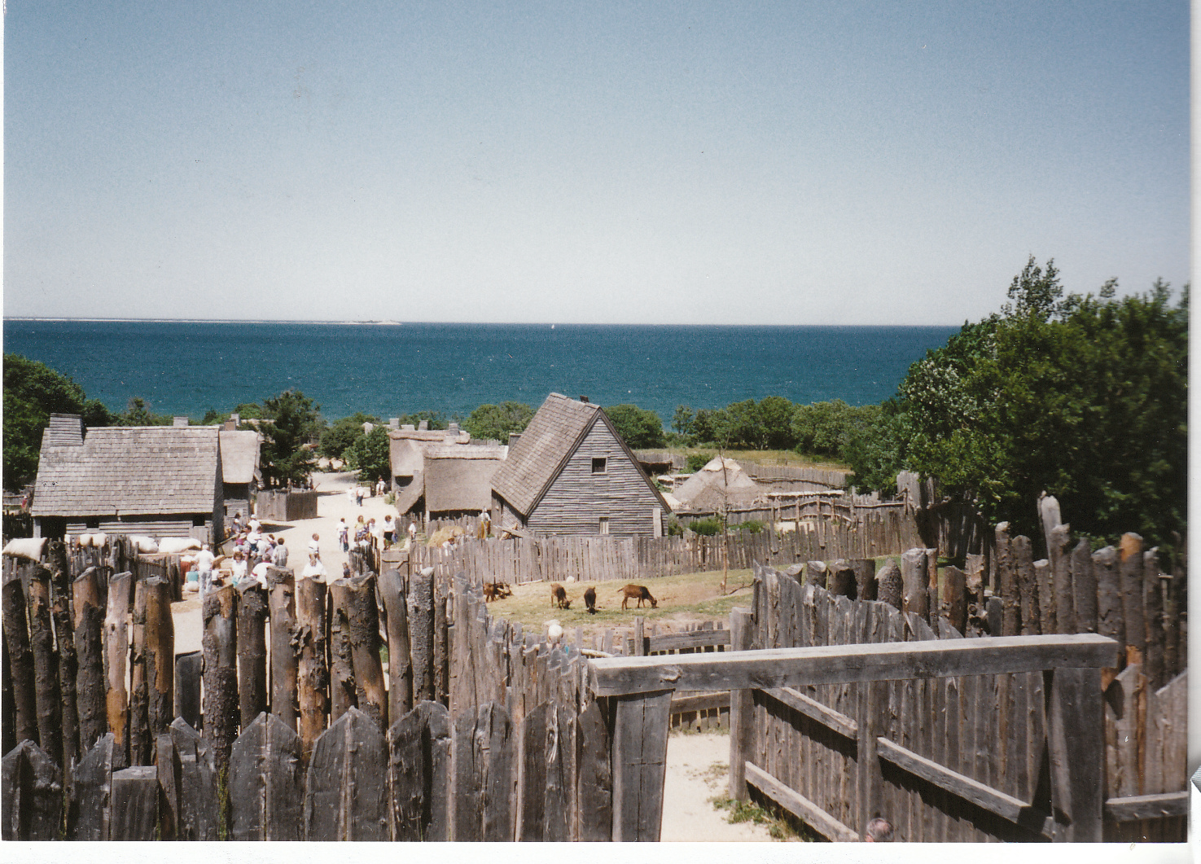
Don’t be copycats!
Ezekiel 20

Slide 2
Don’t be copycats!
Ezekiel 20
What happened on:
22nd Sept.1666?
28th July 1914?
11th Nov.1918?
6th Feb.1952?

Slide 3
Don’t be copycats!
Ezekiel 20
What happened on:
14th August 591 BC?

Slide 4
Don’t be copycats!
Ezekiel 20
The elders’ visit

Slide 5
Don’t be copycats!
Ezekiel 20
The elders’ visit
God’s response
“Son of man, speak to these elders of Israel and say to them, ‘This is what the Sovereign Lord says: Have you come to enquire of me? As surely as I live, I will not let you enquire of me, declares the Sovereign Lord.’”

Slide 6
Don’t be copycats!
Ezekiel 20
The elders’ visit
God’s response
“Son of man, speak to these elders of Israel and say to them, ‘This is what the Sovereign Lord says: Have you come to enquire of me? As surely as I live, I will not let you enquire of me, declares the Sovereign Lord.’”
In Jerusalem – Jeremiah to people: “You will seek me and find me when you seek me with all your heart. I will be found by you and will bring you back from captivity” (Jer.29:13-14).

Slide 7
Don’t be copycats!
Ezekiel 20
The elders’ visit
God’s response
“Son of man, speak to these elders of Israel and say to them, ‘This is what the Sovereign Lord says: Have you come to enquire of me? As surely as I live, I will not let you enquire of me, declares the Sovereign Lord.’”
In Jerusalem – Jeremiah to people: “You will seek me and find me when you seek me with all your heart. I will be found by you and will bring you back from captivity” (Jer.29:13-14).
Why the difference?

Slide 8
Don’t be copycats!
Ezekiel 20
The elders’ visit
God’s response
“Son of man, speak to these elders of Israel and say to them, ‘This is what the Sovereign Lord says: Have you come to enquire of me? As surely as I live, I will not let you enquire of me, declares the Sovereign Lord.’”
In Jerusalem – Jeremiah to people: “You will seek me and find me when you seek me with all your heart. I will be found by you and will bring you back from captivity” (Jer.29:13-14).
Why the difference?
Divided loyalties

Slide 9
Don’t be copycats!
Ezekiel 20
The elders’ visit
God’s response
Israel in Egypt vv.5-9

Slide 10
Don’t be copycats!
Ezekiel 20
The elders’ visit
God’s response
Israel in Egypt vv.5-9
Israelites in desert (1st generation) vv.10-17

Slide 11
Don’t be copycats!
Ezekiel 20
The elders’ visit
God’s response
Israel in Egypt vv.5-9
Israelites in desert (1st generation) vv.10-17
Israelites in desert (2nd generation) vv.18-26

Slide 12
Don’t be copycats!
Ezekiel 20
The elders’ visit
God’s response
Israel in Egypt vv.5-9
Israelites in desert (1st generation) vv.10-17
Israelites in desert (2nd generation) vv.18-26
Not ‘bad laws’ but bad application (vv.25-26)
“I also gave them laws which did them no good and rulings by which they did not live; and I let them become defiled by their own gifts, in that they offered up their firstborn sons, so that I could fill them with revulsion, so that they would [finally] realize that I am Adonai.” (Complete Jewish Bible)

Slide 13
Don’t be copycats!
Ezekiel 20
The elders’ visit
God’s response
Israel in Egypt vv.5-9
Israelites in desert (1st generation) vv.10-17
Israelites in desert (2nd generation) vv.18-26
Not ‘bad laws’ but bad application
6. From conquest to exile vv.27-29

Slide 14
Don’t be copycats!
Ezekiel 20
The elders’ visit
God’s response
Israel in Egypt vv.5-9
Israelites in desert (1st generation) vv.10-17
Israelites in desert (2nd generation) vv.18-26
Not ‘bad laws’ but bad application
From conquest to exile vv.27-29
The unexpected sentence vv.30-44

Slide 15
Don’t be copycats!
Ezekiel 20
The elders’ visit
God’s response
Israel in Egypt vv.5-9
Israelites in desert (1st generation) vv.10-17
Israelites in desert (2nd generation) vv.18-26
Not ‘bad laws’ but bad application
From conquest to exile vv.27-29
The unexpected sentence vv.30-44
Israel’s destiny linked to God’s holiness and glory

Slide 16
Don’t be copycats!
Ezekiel 20
The elders’ visit
God’s response
Israel in Egypt vv.5-9
Israelites in desert (1st generation) vv.10-17
Israelites in desert (2nd generation) vv.18-26
Not ‘bad laws’ but bad application
From conquest to exile vv.27-29
The unexpected sentence vv.30-44
Israel’s destiny linked to God’s holiness and glory
Partial fulfilment under Ezra & Nehemiah

Slide 17
Don’t be copycats!
Ezekiel 20
The elders’ visit
God’s response
Israel in Egypt vv.5-9
Israelites in desert (1st generation) vv.10-17
Israelites in desert (2nd generation) vv.18-26
Not ‘bad laws’ but bad application
From conquest to exile vv.27-29
The unexpected sentence vv.30-44
Israel’s destiny linked to God’s holiness and glory
Partial fulfilment under Ezra & Nehemiah
Ongoing fulfilment through New Covenant

Slide 18
Don’t be copycats!
Ezekiel 20
The elder’s visit
God’s response
Israel in Egypt vv.5-9
Israelites in desert (1st generation) vv.10-17
Israelites in desert (2nd generation) vv.18-26
Not ‘bad laws’ but bad application
From conquest to exile vv.27-29
The unexpected sentence vv.30-44
Israel’s destiny linked to God’s holiness and glory
Partial fulfilment under Ezra & Nehemiah
Ongoing fulfilment through New Covenant
Rebellious Israel

Slide 19
Don’t be copycats!
Ezekiel 20
The elder’s visit
God’s response
Israel in Egypt vv.5-9
Israelites in desert (1st generation) vv.10-17
Israelites in desert (2nd generation) vv.18-26
Not ‘bad laws’ but bad application
From conquest to exile vv.27-29
The unexpected sentence vv.30-44
Israel’s destiny linked to God’s holiness and glory
Partial fulfilment under Ezra & Nehemiah
Ongoing fulfilment through New Covenant
Rebellious Israel
“Copycats” (v.32)

Slide 20
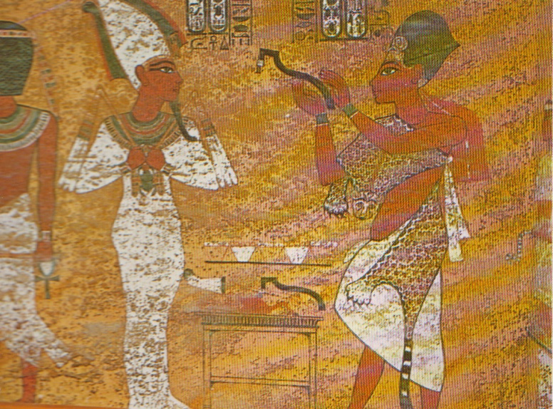
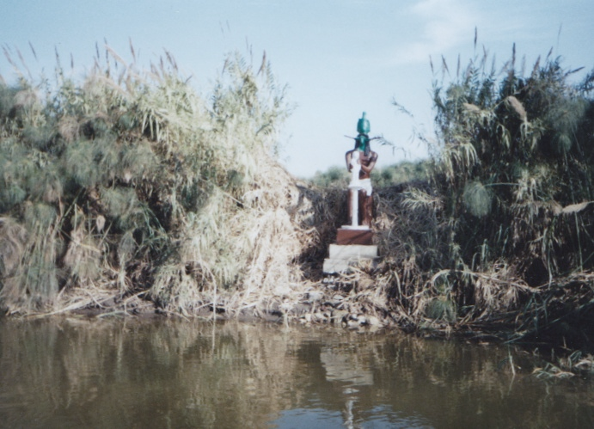
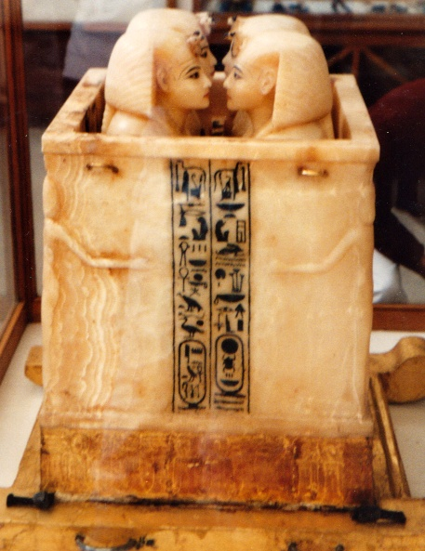
Don’t be copycats!
Ezekiel 20
The elder’s visit
God’s response
Israel in Egypt vv.5-9
Israelites in desert (1st generation) vv.10-17
Israelites in desert (2nd generation) vv.18-26
Not ‘bad laws’ but bad application
From conquest to exile vv.27-29
The unexpected sentence vv.30-44
Israel’s destiny linked to God’s holiness and glory
Partial fulfilment under Ezra & Nehemiah
Ongoing fulfilment through New Covenant
What was the attraction?
Rebellious Israel
“Copycats” (v.32)

Slide 21
Don’t be copycats!
Ezekiel 20
What was the attraction?
The repetition factor
Rebellious Israel
“Copycats” (v.32)

Slide 22
Don’t be copycats!
Ezekiel 20
What was the attraction?
The repetition factor
The sexual factor
Rebellious Israel
“Copycats” (v.32)

Slide 23
Don’t be copycats!
Ezekiel 20
What was the attraction?
The repetition factor
The sexual factor
The proximity factor
Rebellious Israel
“Copycats” (v.32)

Slide 24
Don’t be copycats!
Ezekiel 20
What was the attraction?
The repetition factor
The sexual factor
The proximity factor
Same phenomenon in NT times:
John’s warning “Do not love the world or anything in the world. If anyone loves the world, love for the Father is not in them. For everything in the world – the lust of the flesh, the lust of the eyes, and the pride of life – comes not from the Father but from the world. The world and its desires pass away, but whoever does the will of God lives for ever (1 John.2:15-17).
Rebellious Israel
“Copycats” (v.32)

Slide 25
Don’t be copycats!
Ezekiel 20
What was the attraction?
The repetition factor
The sexual factor
The proximity factor
Same phenomenon in NT times:
John’s warning
Paul’s warnings – Galatians, Corinthians, Ephesians
Rebellious Israel
“Copycats” (v.32)

Slide 26
Don’t be copycats!
Ezekiel 20
What was the attraction?
The repetition factor
The sexual factor
The proximity factor
Same phenomenon in NT times:
John’s warning
Paul’s warnings – Galatians, Corinthians, Ephesians
General tendency to conform
Rebellious Israel
“Copycats” (v.32)

Slide 27
Don’t be copycats!
Ezekiel 20
What was the attraction?
The repetition factor
The sexual factor
The proximity factor
Same phenomenon in NT times:
John’s warning
Paul’s warnings – Galatians, Corinthians, Ephesians
General tendency to conform
Francis Schaeffer: “Tell me what the world is saying, and I’ll tell you what the church will be saying in ten or twenty years.”
Rebellious Israel
“Copycats” (v.32)

Slide 28
Don’t be copycats!
Ezekiel 20
What was the attraction?
The repetition factor
The sexual factor
The proximity factor
Same phenomenon in NT times
Modern pressures: conformism, sexuality, accountability
Rebellious Israel
“Copycats” (v.32)

Slide 29
Don’t be copycats!
Ezekiel 20
What was the attraction?
The repetition factor
The sexual factor
The proximity factor
Same phenomenon in NT times
Modern pressures: conformism, sexuality, accountability
Our response? Resist the pressures!
Rebellious Israel
“Copycats” (v.32)

Slide 30
Don’t be copycats!
Ezekiel 20
What was the attraction?
The repetition factor
The sexual factor
The proximity factor
Same phenomenon in NT times
Modern pressures: conformism, sexuality, accountability
Our response? Resist the pressures!
Rebellious Israel
“Copycats” (v.32)
Biblical regarding creation

Slide 31
Don’t be copycats!
Ezekiel 20
What was the attraction?
The repetition factor
The sexual factor
The proximity factor
Same phenomenon in NT times
Modern pressures: conformism, sexuality, accountability
Our response? Resist the pressures!
Rebellious Israel
“Copycats” (v.32)
Biblical regarding creation
Biblical regarding salvation

Slide 32
Don’t be copycats!
Ezekiel 20
What was the attraction?
The repetition factor
The sexual factor
The proximity factor
Same phenomenon in NT times
Modern pressures: conformism, sexuality, accountability
Our response? Resist the pressures!
Rebellious Israel
“Copycats” (v.32)
Biblical regarding creation
Biblical regarding salvation
Biblical regarding sexuality

Slide 33
Don’t be copycats!
Ezekiel 20
What was the attraction?
The repetition factor
The sexual factor
The proximity factor
Same phenomenon in NT times
Modern pressures: conformism, sexuality, accountability
Our response? Resist the pressures!
Rebellious Israel
“Copycats” (v.32)
Biblical regarding creation
Biblical regarding salvation
Biblical regarding sexuality
Biblical regarding judgment

